Slide 1
Презентация ежегодного доклада ЮНКТАД на онлайн-площадке ИНИОН РАН
INVESTING IN SUSTAINABLE RECOVERY

Slide 2
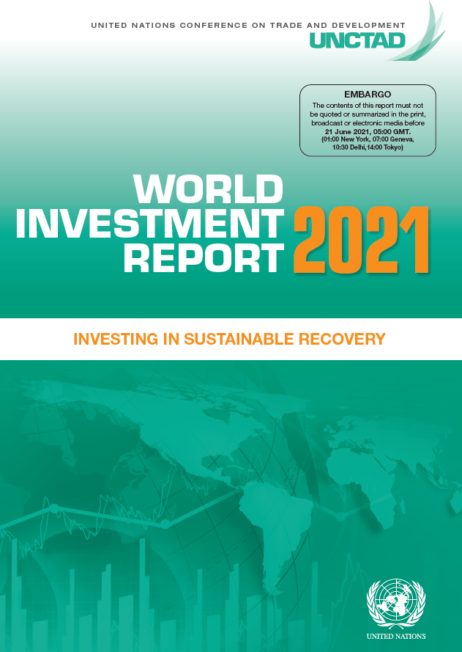
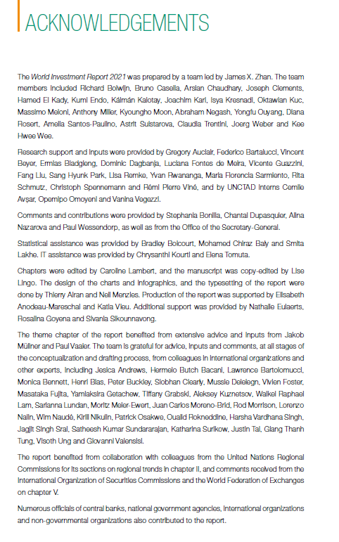
Материалы доклада о мировых инвестициях традиционно доступны онлайн на сайте ЮНКТАД – https://unctad.org/webflyer/world-investment-report-2021
Сам доклад (https://unctad.org/system/files/official-document/wir2021_en.pdf) – 279 стр. (уже доступен) + пресс-релизы + онлайн-таблицы с более детальной статистикой, которые вывешивают чуть позже

Slide 3
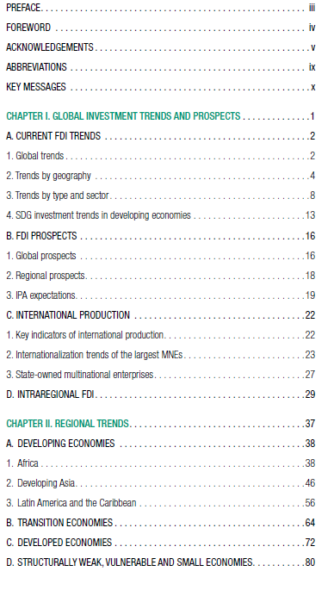
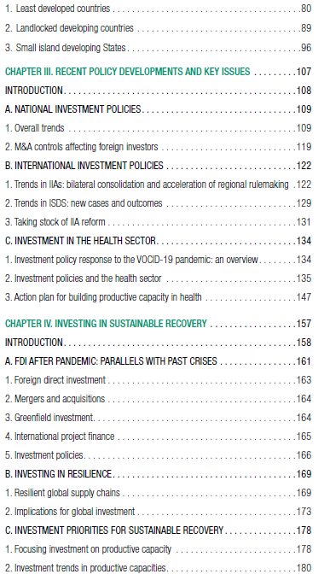
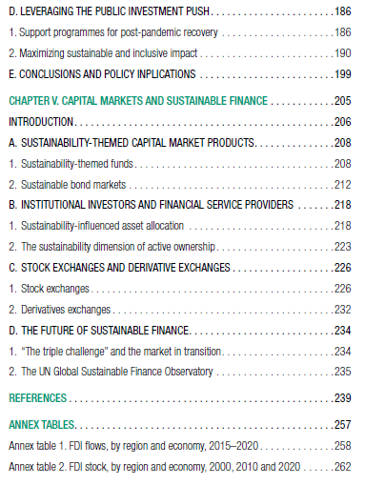
Оглавление WIR2021

Slide 4
Investment trends and prospects
Investment policy developments
Investing in sustainable recovery
Capital markets and sustainable finance

Slide 5
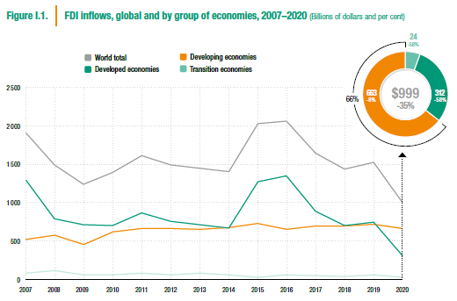
Global FDI fell below $1 trillion, lowest level for 15 years

Slide 6
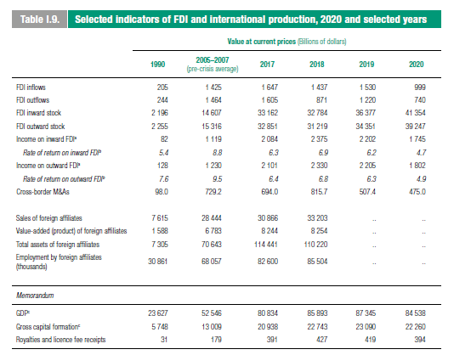

Slide 7
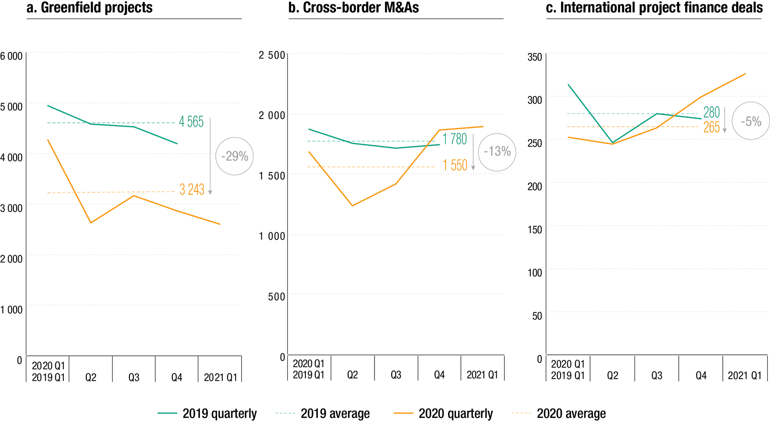
Investment fell across all types – greenfield still not showing signs of recovery
Announced greenfield projects, cross-border M&As and international project finance deals,
2019 Q1–2021 Q1

Slide 8
Contrasting trends in developed and developing economies
FDI inflows, by region, 2019 and 2020
(Billions of dollars and per cent)

Slide 9
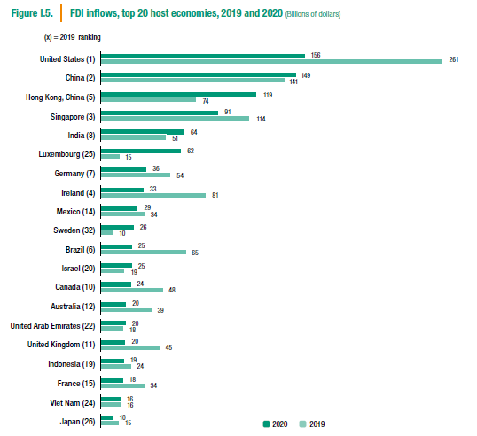
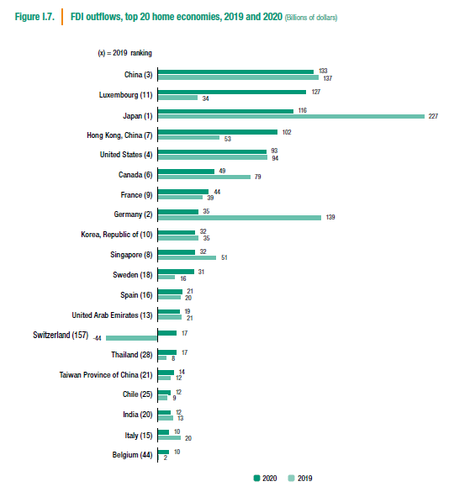
Russia: 32.1 → 9.7
Russia: 22.0 → 6.3

Slide 10
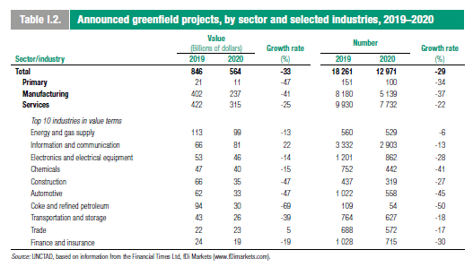
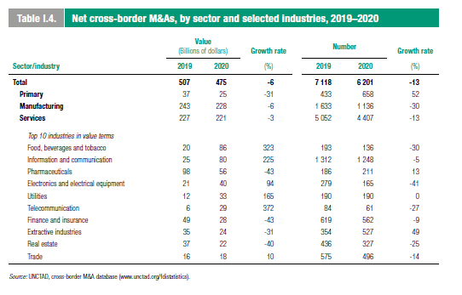
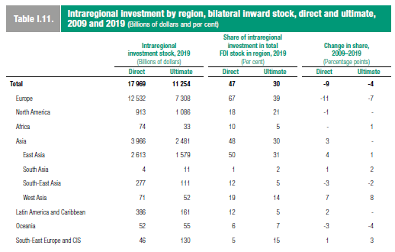
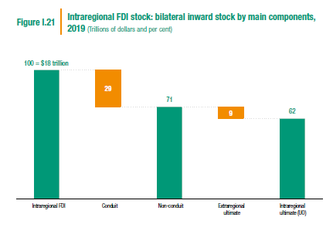

Slide 11
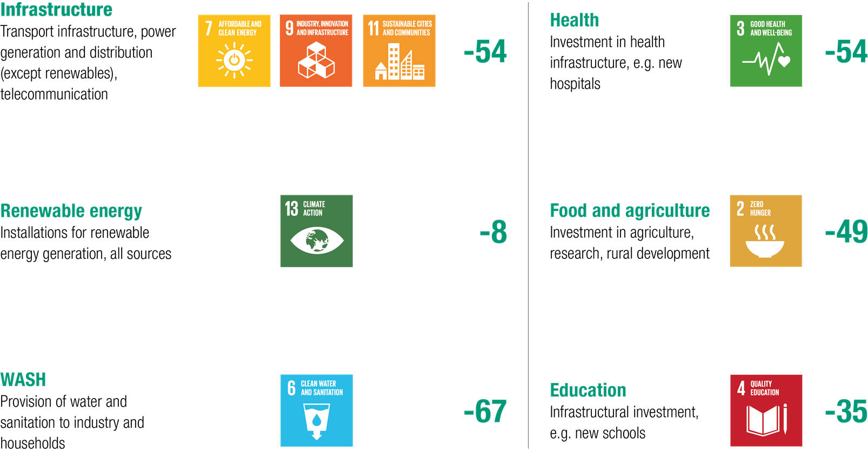
Progress since 2015 in promoting investment in the SDGs has been largely undone by the pandemic
Announced greenfield and project finance, change in value, 2019–2020 (Per cent)

Slide 12
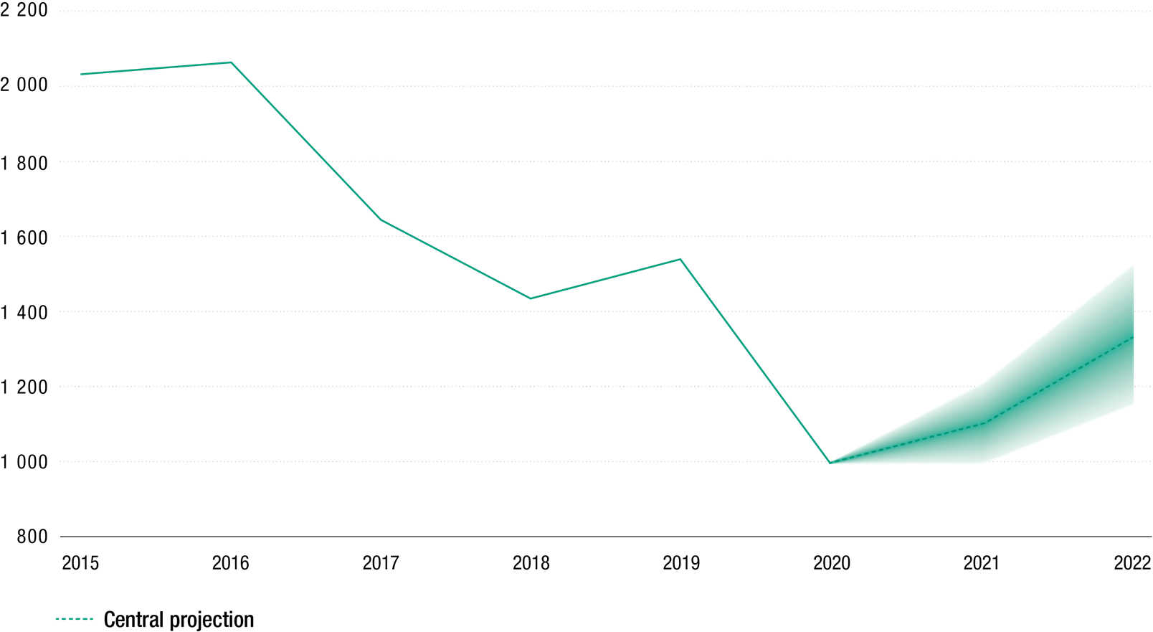
UNCTAD expects a bottoming out of FDI in 2021, and an initial recovery
Global FDI inflows, 2015–2020 and 2021–2022 forecast
(Billions of dollars)

Slide 13
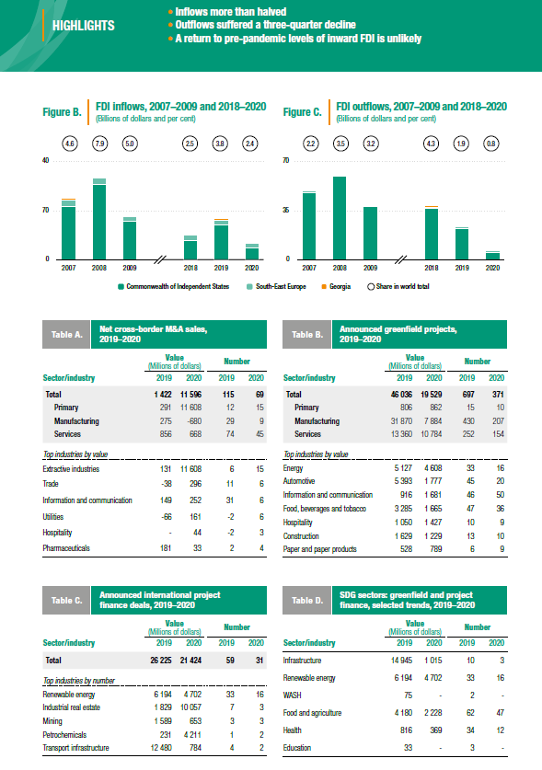
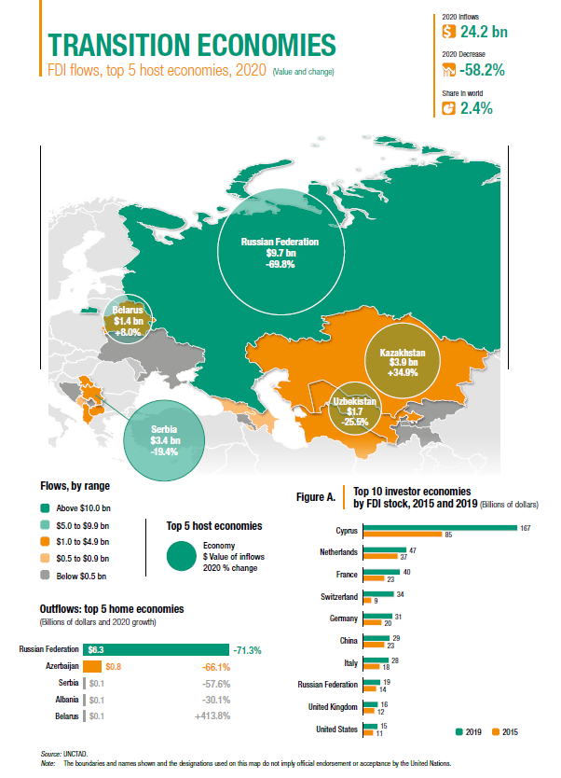

Slide 14
Investment trends and prospects
Investment policy developments
Investing in sustainable recovery
Capital markets and sustainable finance

Slide 15
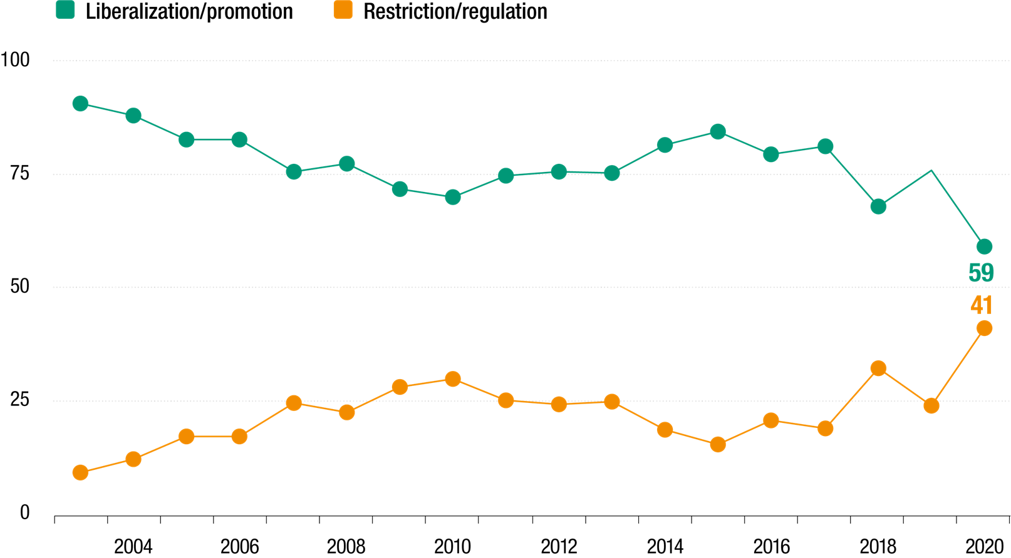
The share of more restrictive/regulatory policies reached a record high
Changes in national investment policies, 2003–2020 (Per cent)

Slide 16
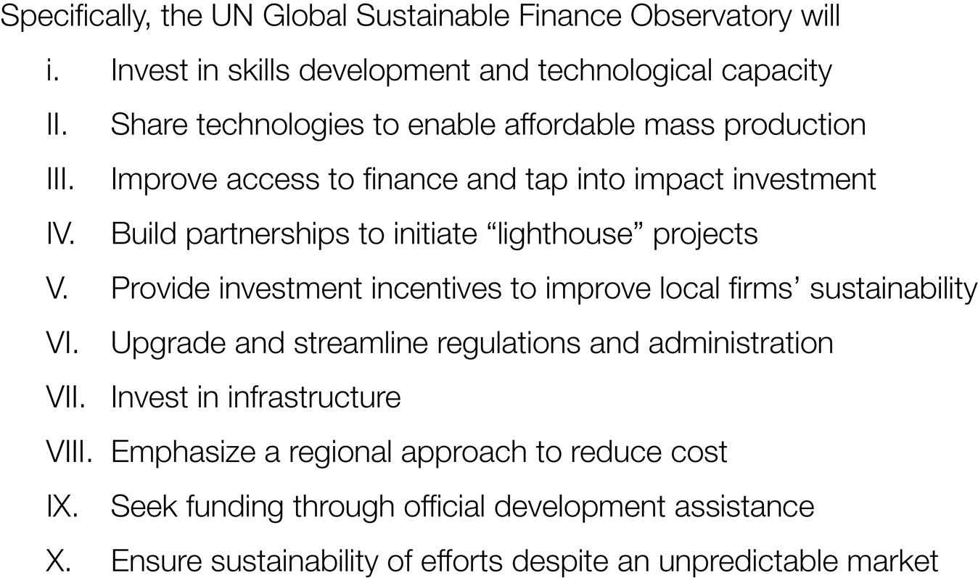
UNCTAD launches its Investing in Health Initiative, targeted at low and lower middle income countries

Slide 17
Investment trends and prospects
Investment policy developments
Investing in sustainable recovery
Capital markets and sustainable finance

Slide 18
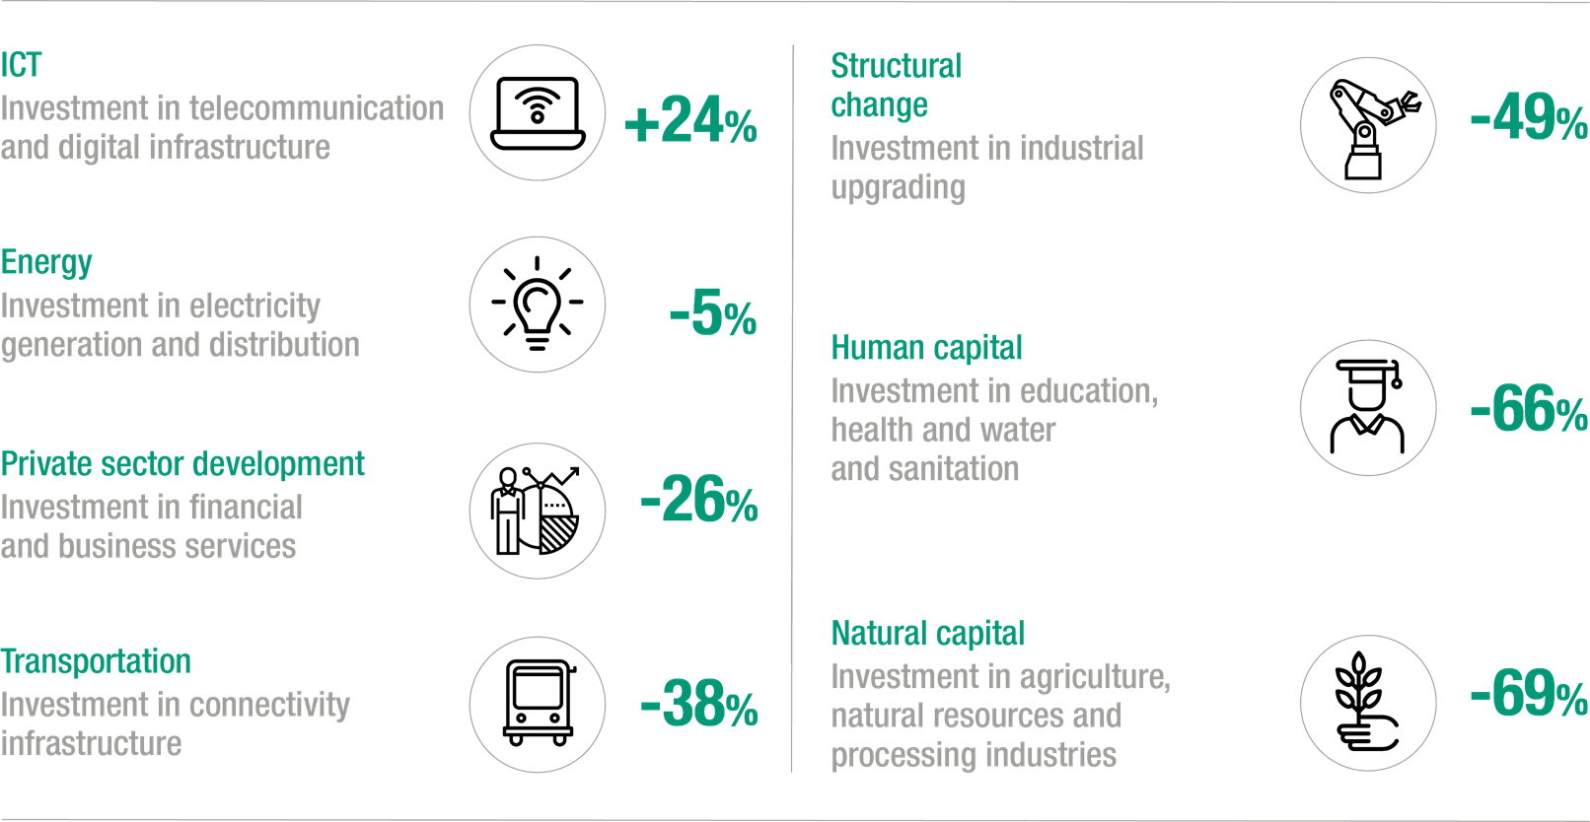
Investment in industry has been hit harder by the pandemic than investment in infrastructure
The impact of the pandemic on investment in productive capacity: a snapshot

Slide 19
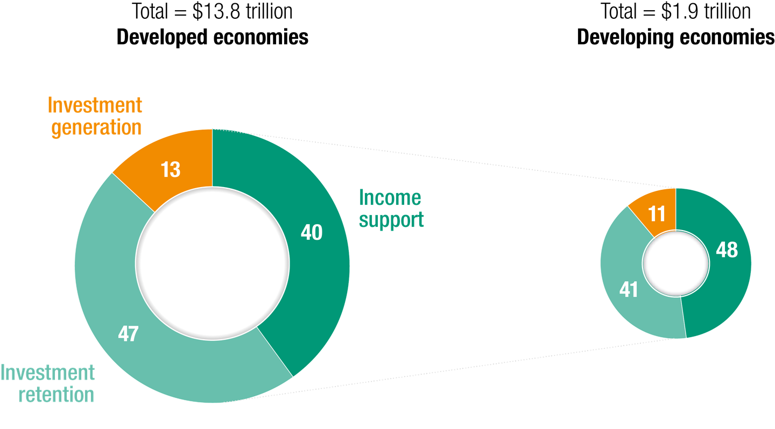
The bulk of recovery investment packages are in developed countries, but the impact on international investment will be global
Stimulus programs: rescue and recovery (Trillions of dollars and per cent)

Slide 20
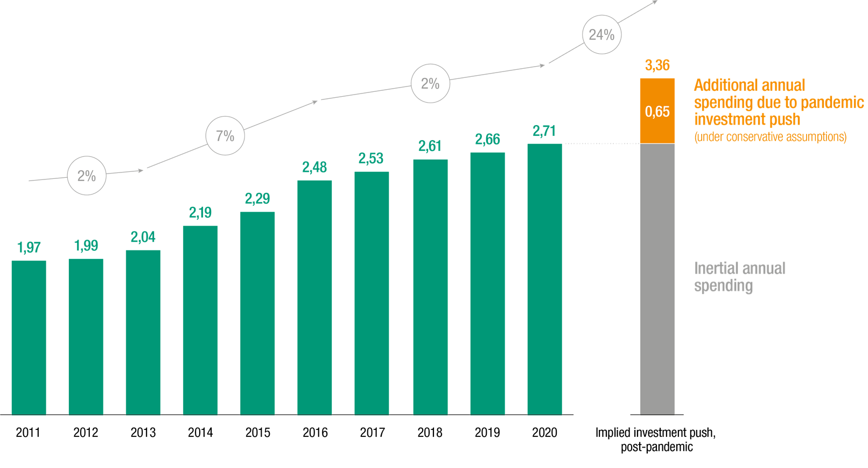
The increase in infrastructure investment implied by recovery packages is at least 3 times the fastest rate of growth of the last decade
Total spending in infrastructure, historical and expected (Trillions of dollars and per cent)

Slide 21
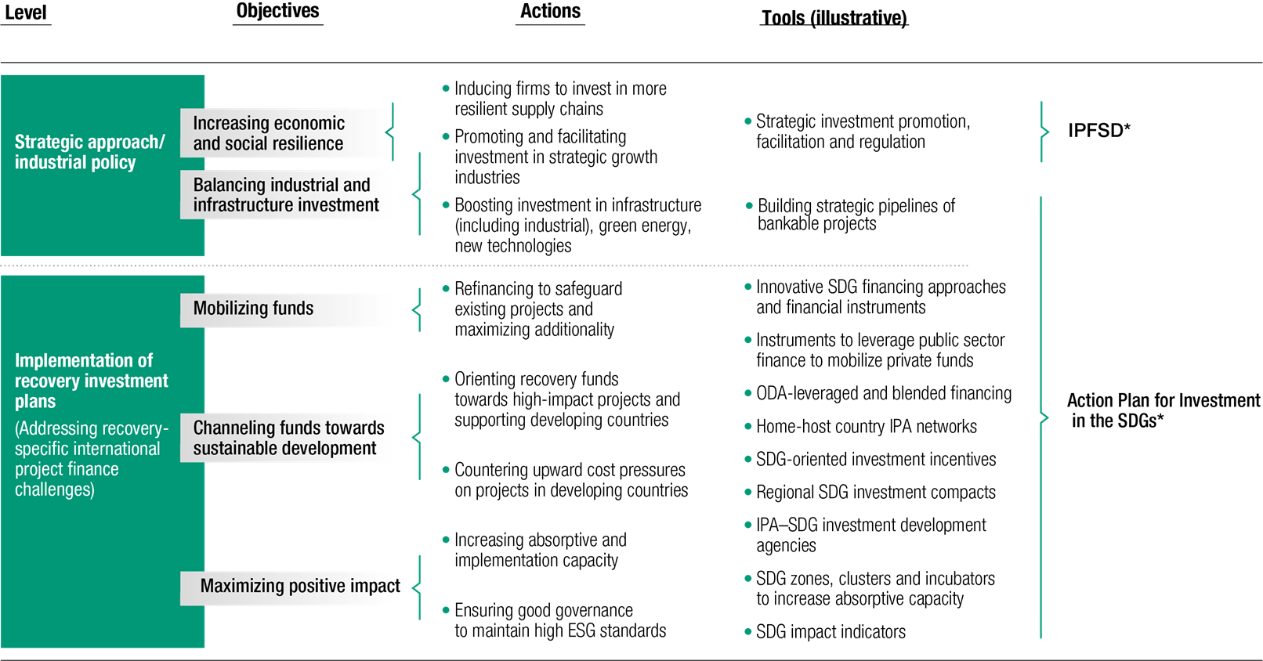
Investing in Sustainable Recovery: a Policy Framework

Slide 22
Investment trends and prospects
Investment policy developments
Investing in sustainable recovery
Capital markets and sustainable finance

Slide 23
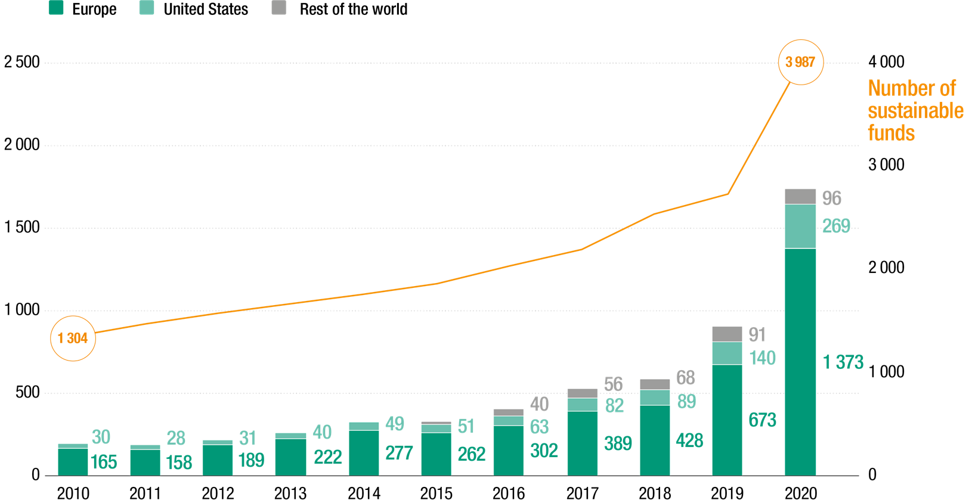
Sustainable funds are growing fast
Number of sustainable funds and assets under management, 2010–2020 (Billions of dollars)

Slide 24
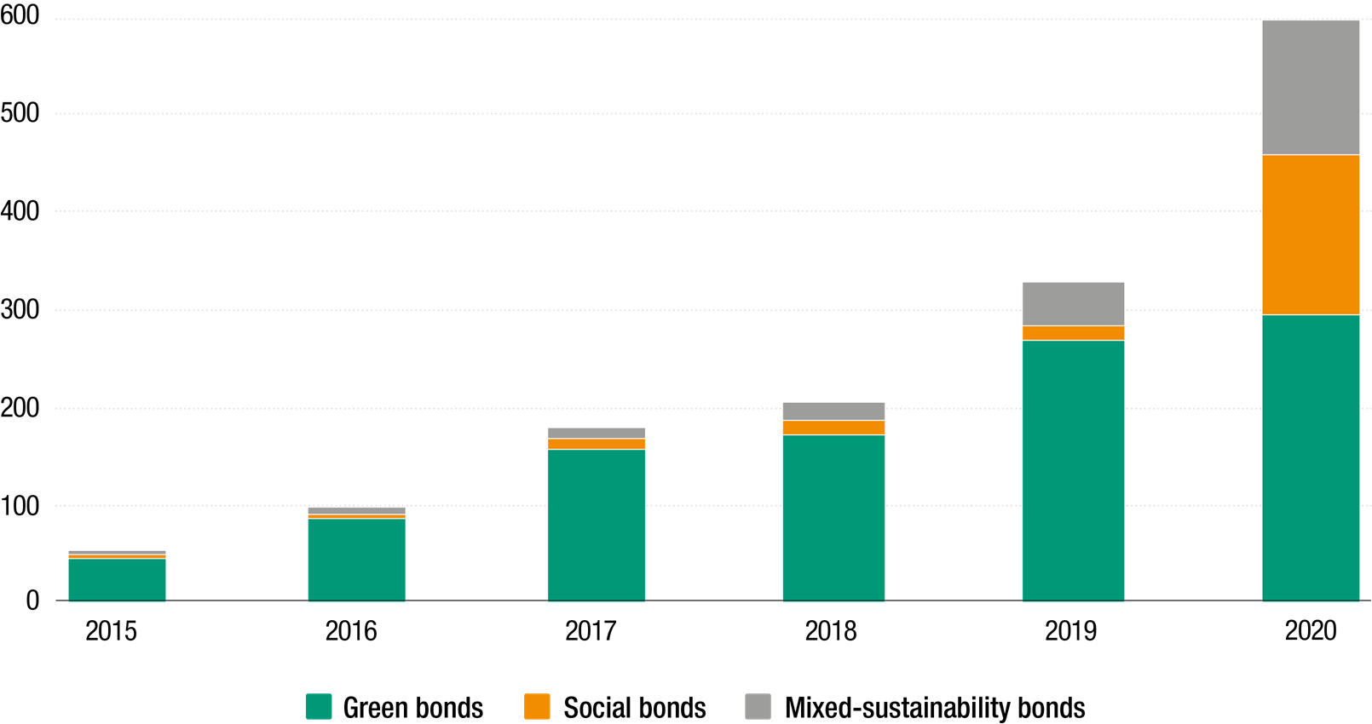
Sustainable bonds booming, with social and mixed bonds catching up
Growth in the sustainable bond market, 2015–2020
(Billions of dollars)

Slide 25
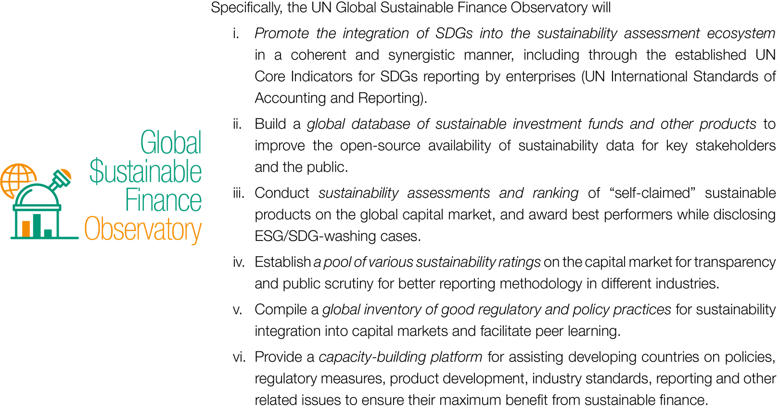
UNCTAD launches the Global Sustainable Finance Observatory

